Slide 1

Brazilian E-Commerce Olist’s performance analysis
By Bluceli

Slide 2
PROJECT OVERVIEW
This project we explore an Brazilian E-Commerce’s Olist history operation datasets from kaggle to seek any possibilities to optimize human resource allocation and improve overall sales performance.
Olist was established in 2015 and now is still running smoothly with url: https://olist.com/

Slide 3
DATA OVERVIEW AND HANDLING
We totally got 8 separate datasets in below aspects:
customers/orders/payment/reviews/sellers/products/delivery
We cleaned the dataset by removing null-values, many helpless columns ,recast some data types and removed certain outliers for better visualisation
we also insert some helpful columns in favor of later analysis
finally all datasets were merged to final cleaned dataframe for comprehensive analysis
original data volumn from 116.5k rows decrease to 108.2k ( drop 7.1%)
import into MySQL to do 3 comprehensive queries.

Slide 4
KPI AND PERFORMANCE METRICS
To evaluate general performance we looked at below main KPI’s:
Sales percentage by states
Product catelog distribution
Unit price distribution
Satisfaction scores
Time spent throughout all steps of orders

Slide 5
Exploratory Data Analysis
For general performance let’s turn to Presentation in Tableau

Slide 6
Basing on above exploration , i came up below Questions to figure out
1 - Are Any key Numerical Variables Closely Correlated?
2 - Are Customers Willing to Pay More for Faster Delivery?
3 - Does Spending more lead to higher review scores?
4 - Hypothesis Testing :is there any difference in customer satisfaction between orders with standard and express shipping

Slide 7
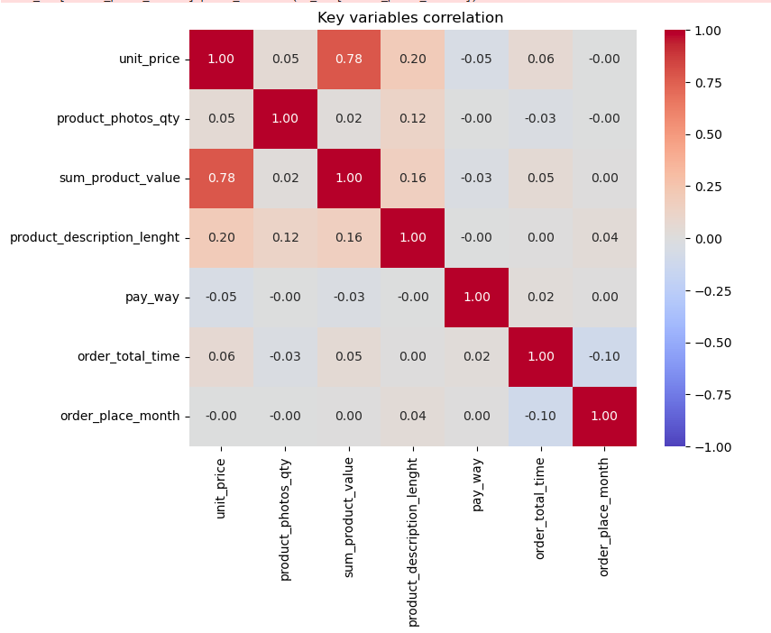
Are Any key Numerical Variables Closely Correlated?
Top related variables pairs :
1- unit_price VS sum_value : 0.78
2- unit_price VS product_description: 0.20
3- sum_value VS product_description : 0.16

Slide 8
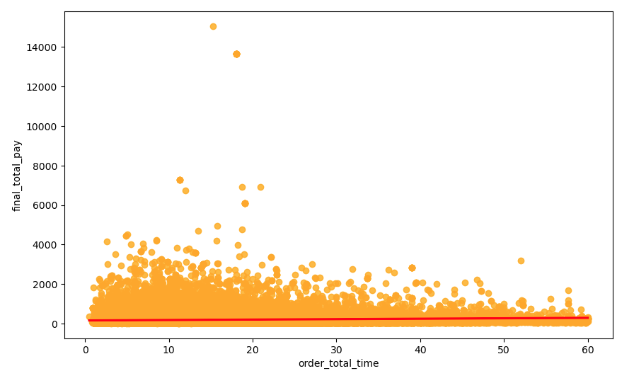
Are Customers Willing to Pay More for Faster Delivery?
Scatter plot illustrate relationship between
Total order time VS Total_Pay value:
it is clear that most customers are paying relatively low regardless of total order time,
with only a few outliers paying significantly higher amounts

Slide 9
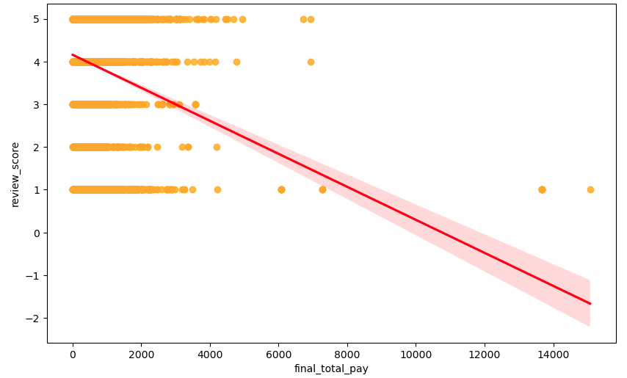
Does Spending more lead to higher review scores?
The Scatter plot shows a negative trend in
Final_total_pay VS Review_score
Higher payments slightly correlated with lower review scores,though most scores cluster around 4-5 stars.
this suggests paying moe doesn’t guarantee better reviews.

Slide 10
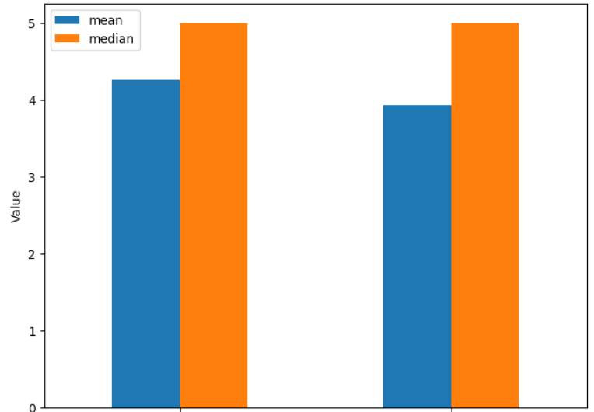
Hypothesis Testing
H0: There is no difference in customer satisfaction between orders with standard and express shipping
H1: Orders with express shipping have higher customer satisfaction compared with standard shipping
We first use K-S Test to verity if reviews_score column data between standard VS express group are normal distributed:
K-S test result：both group’s P value are lower than Significance level : 0.01, means they are not normal distributed.
so we further use “mannwhitneyu” way to further test and get below result :
U_Statistic: 1653455212.5// P_value:0.0 ( < significance 0.05)
Initial test result : we can reject H0 hypothesis
And below traditional calculation also prove H1 hypothesis is right
df mean review median
0 df1(express carrier) 4.257982 5.0
1 df2(standard carrier) 3.927599 5.0
Final conclusion：Orders with express shipping have generally higher customer satisfaction than standard shipping .

Slide 11
Challenges & Learnings
Original datas missing some key infors columns such as customer age,customer gender and unit price,purchase qty which lead to extra hours to calculate out by multi math calculations.
product value + freight totally have 22.5% gap compare with customer total paid value in whole dataset, and it extra took lots of time to figure out :
root reason:many rows freight are repeated-calculated in same order_id
solution: handled repeated-calculated freight parts by new valid functions in new columns
frequently found extra un-cleaned data while doing visualization in Tableau and have to back to python to clear it and then update new raw data into Tableau again even for finished separated tableau sheet

Slide 12
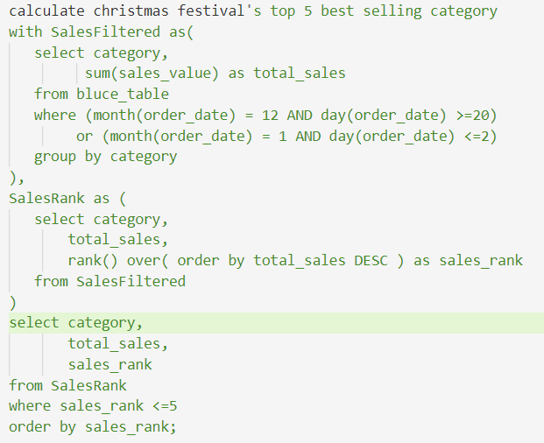
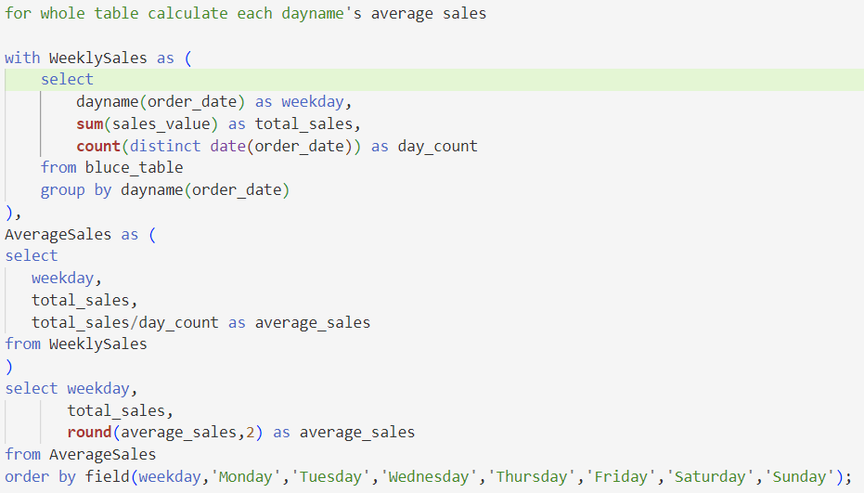
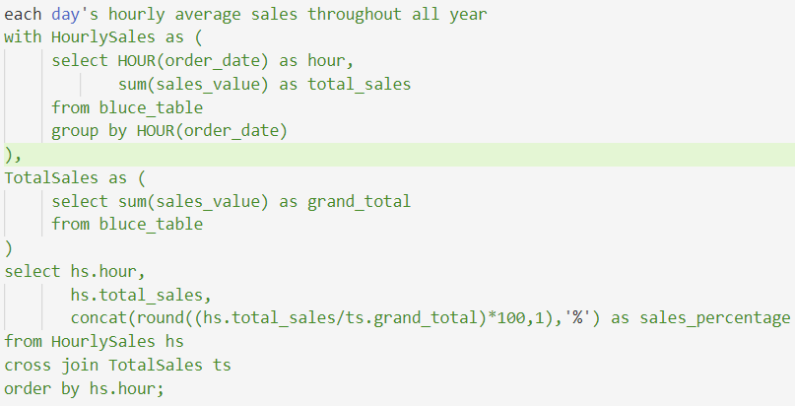
MySQL Exploration - query

Slide 13
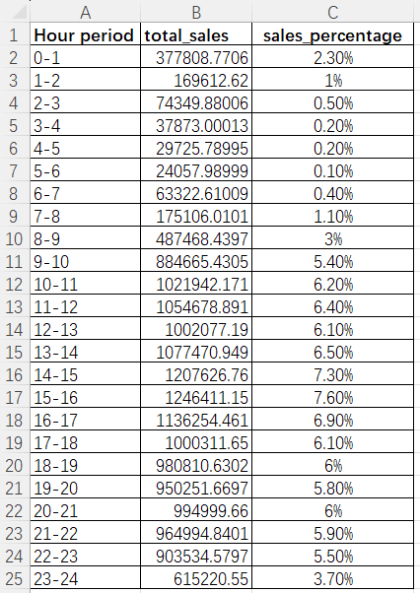
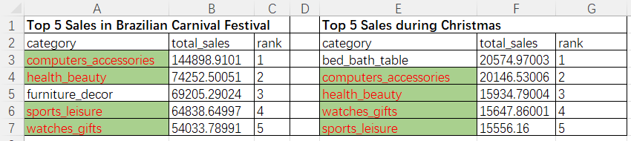
MySQL Exploration - results

Slide 14
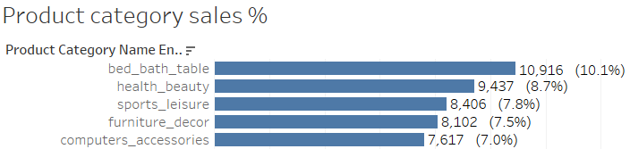
Conclusion & Advices
1- Sellers should properly increase their product description length to obtain better sales performance
2- Platform need to greatly improve those high paying orders’ customer experiencs ( especially value > 3000 usd orders) because this can greatly improve average reviews score.
3- We advocate Platform to allocate more labors in Feb, March.Nov and Dec as the 4 months took the average longest order total time
4- Below totally 6 best seller catalogies are highly advocated to invest more in marketing/or favorable discounts…ect in different festival period of each year to achieve best sales performance.

Slide 15
that’s all, thank you

